Slide 1


GROUP NO : 26
AUTOMATED
WEB SCRAPING
DEPARTMENT OF COMPUTER SCIENCE AND ENGINEERING
TEAM MEMBERS:
VANSH DHARMANI [300102220086]
YAMAN KUMAR SAHU [300102220092]
ROHIT KUSHWAHA [300102220127]
PROJECT SUPERVISOR : PROF. S.D. MISHRA
PROJECT GUIDE : PROF. JYOTI GUPTA

Slide 2


PROBLEM STATEMENT
Manual web scraping is labor-intensive, prone to errors, and lacks scalability, hindering efficient data collection and analysis.

Slide 3

LITERATURE-REVIEW
Webs scrapping allows the extraction of huge amount of data that is constantly generated online with a relatively low cost.
Web browsers like Mozilla controls enables accessing dynamic content created by client-side scripts and parsing web pages into a Document Object Model tree.
Traditional web scraping involves manual copy-and-paste techniques, effective for small datasets but tedious for large ones.
Utilizing regular expressions for text extraction from web pages leverages UNIX commands or programming languages' pattern-matching features, enabling efficient data retrieval.
DOM PARSING
COPY AND PASTE
USING REG-EX

Slide 4
GOALS AND OBJECTIVES
Objective n° 1
Objective n° 2
Objective n° 3
Extract relevant data from target websites by using user defined specific information , such as product details, news articles, pricing data, or any other relevant content.
Utilizing automated web scraping tools to streamline the extraction process, save time, and ensure data accuracy.
Live dashboard automatically updates data at fixed intervals, ensuring up-to-date insights for users.

Slide 5

TECHNOLOGIES USED
01
PYTHON
02
GOOGLE COLAB
03
OPEN-AI LIBRARIES
04
HUGGING-FACE LIBRARY MARKUPLM
05
HTML,CSS AND JAVASCRIPT

Slide 6
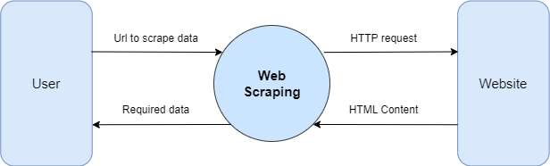
Data Flow Diagram:
Level 0

Slide 7
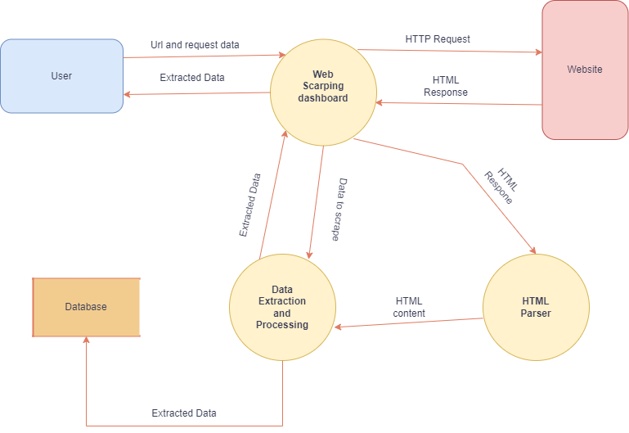
Level 1:

Slide 8
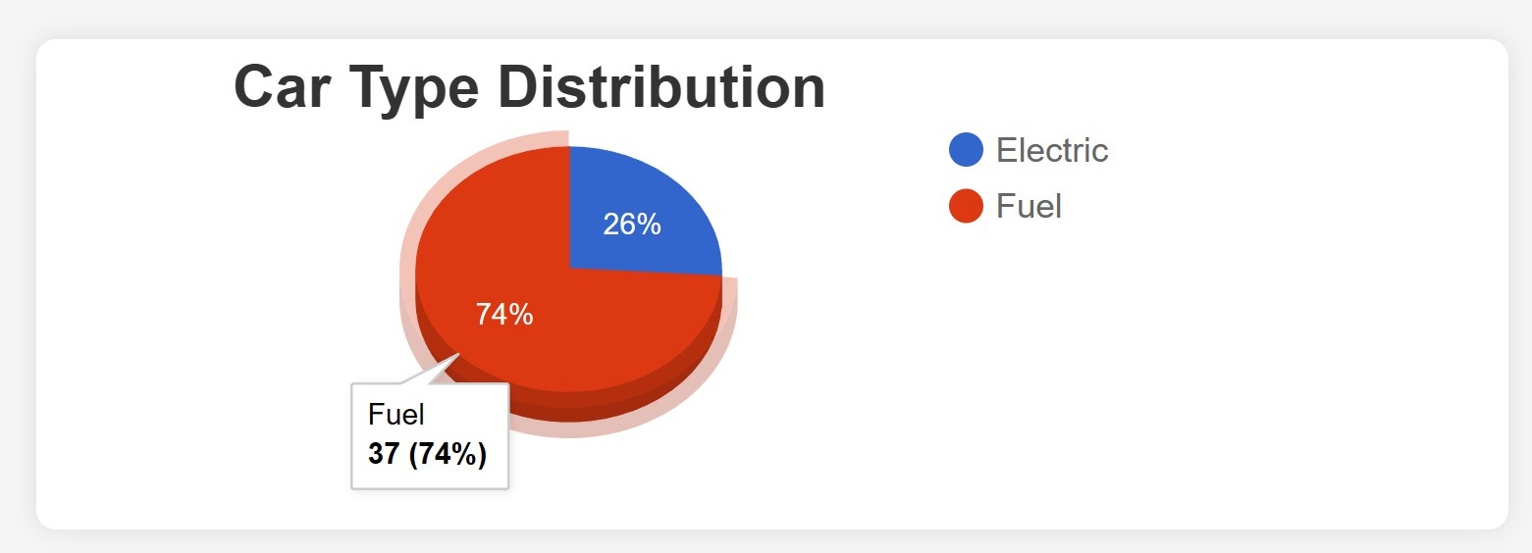
SCREENSHOTS

Slide 9
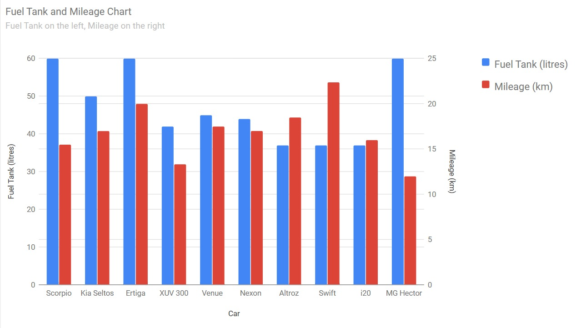
SCREENSHOTS

Slide 10

USE CASES
E-commerce
Job Postings
Explore real-time pricing, promotions and availability
Collect product details, reviews, or product Q&A
Match the data against your existing product catalog
Get alerts to key data points like out of stock
Collect job postings from any career page and job board
Import jobs from career sites regardless of ATS
Identify companies actively hiring for high-quality roles
Track labor market trends in real-time

Slide 11
OVERCOMING WEB SCRAPING CHALLENGES
Strategies for Addressing Potential Issues
DEALING WITH CAPTCHA
EMPLOY AUTOMATED SOLUTIONS OR HUMAN INTERVENTION TO BYPASS CAPTCHA CHALLENGES DURING WEB SCRAPING PROCESSES.
2. HANDLING DYNAMIC WEBSITES
IMPLEMENT TECHNIQUES TO NAVIGATE AND EXTRACT DATA FROM WEBSITES WITH DYNAMIC CONTENT EFFICIENTLY.
3. ENSURING COMPLIANCE WITH WEBSITE TERMS OF USE
DEVELOP PROTOCOLS TO ADHERE TO WEBSITE TERMS OF USE AND LEGAL REGULATIONS WHILE SCRAPING DATA TO AVOID POTENTIAL LEGAL ISSUES.

Slide 12
REFERENCES
[1] Almaqbali, I. S., Al Khufairi, F. M., Khan, M. S., Bhat, A. Z., Ahmed, (2019). Web Scrapping: Data Extraction from Websites. Journal of Student Research.
[2] Asma. (2021, September 29). The Future of Web Scraping Services.
[3] Banerjee, R. (2014). Website Scraping. Happiest Minds Technologies Pvt. Ltd.
[4] Manjushree, B.S and Sharvani, G.S, 2020. Survey on Web scraping technology. Wutan Huatan Jisuan Jishu, XVI(VI pp.1-8

Slide 13

THANK YOU
FOR
LISTENING.

